Slide 1
Password Generator
Maribeth
Richard
Steven

Slide 2
Content
1. What is a Password Generator
2. Why we choose this project
3. Technologies
4. Methodology
5. Team work
6. Reflections
7. Q & A
8. References

Slide 3
What is Password Generator
Create a random password while we are registering or modifying in websites, apps
Platforms:
Computers/Laptop(Mac & Windows), phones(IOS & Android), tablets(Ipads & other brand) and so on.

Slide 4
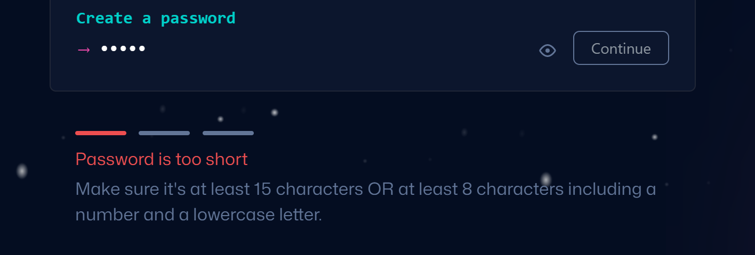
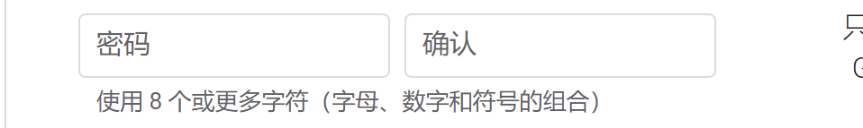
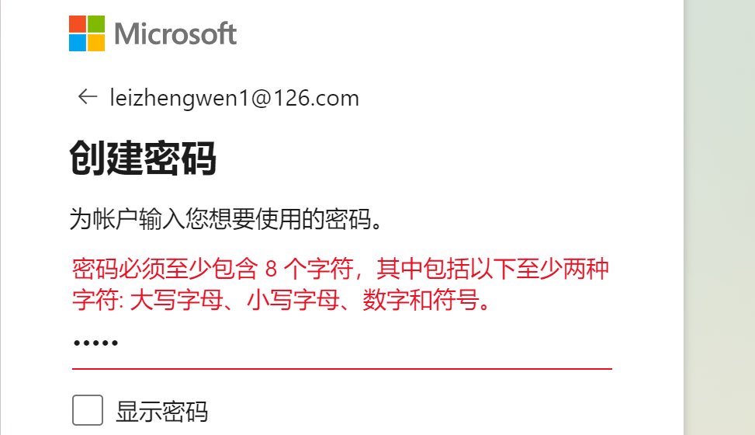
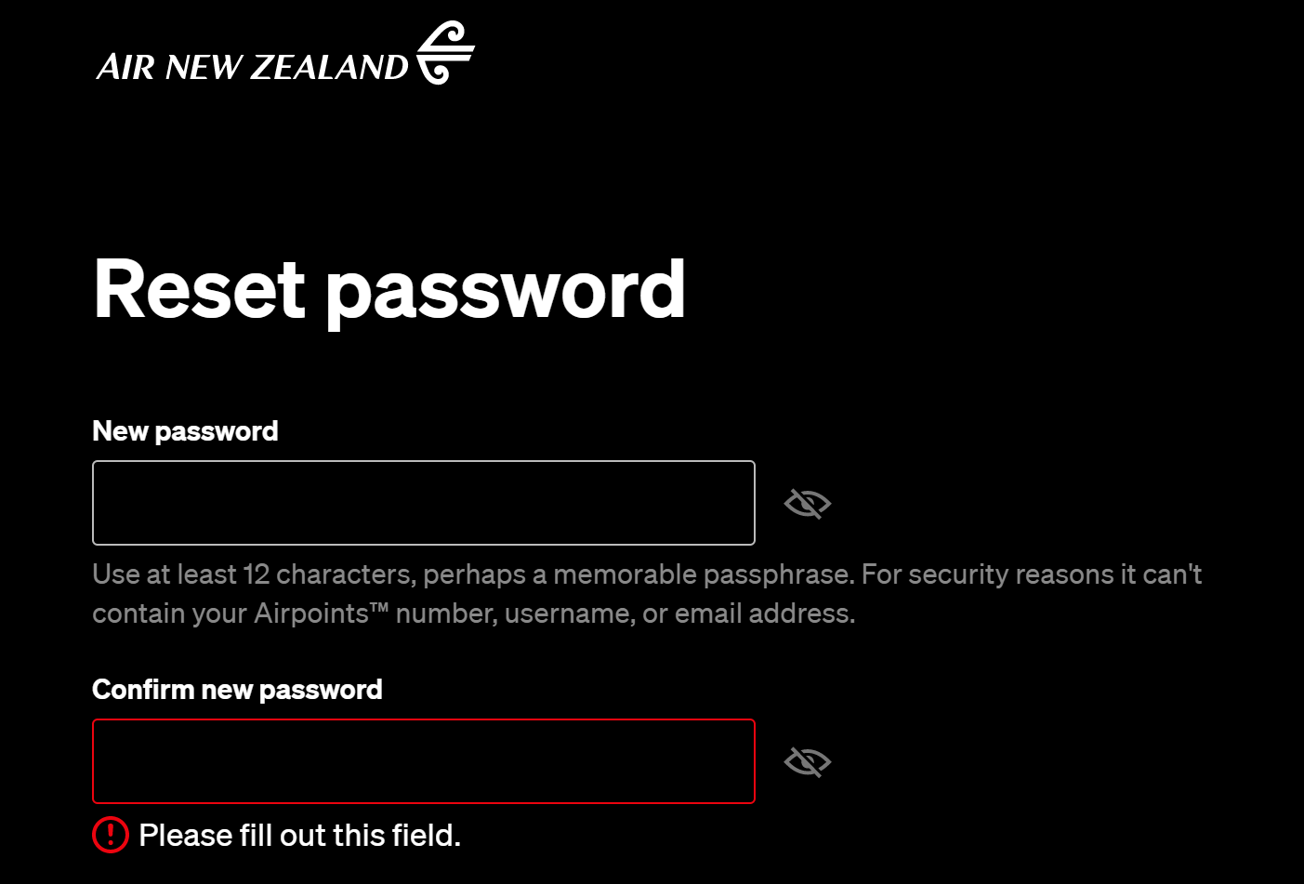
Why we choose this project
Hard to create an ideal password

Slide 5
Why we choose this project
Unlikely to create a strong password
123456,1234567890
qwert, qwertyuiop
123456qwerty, 1qaz2wsx

Slide 6
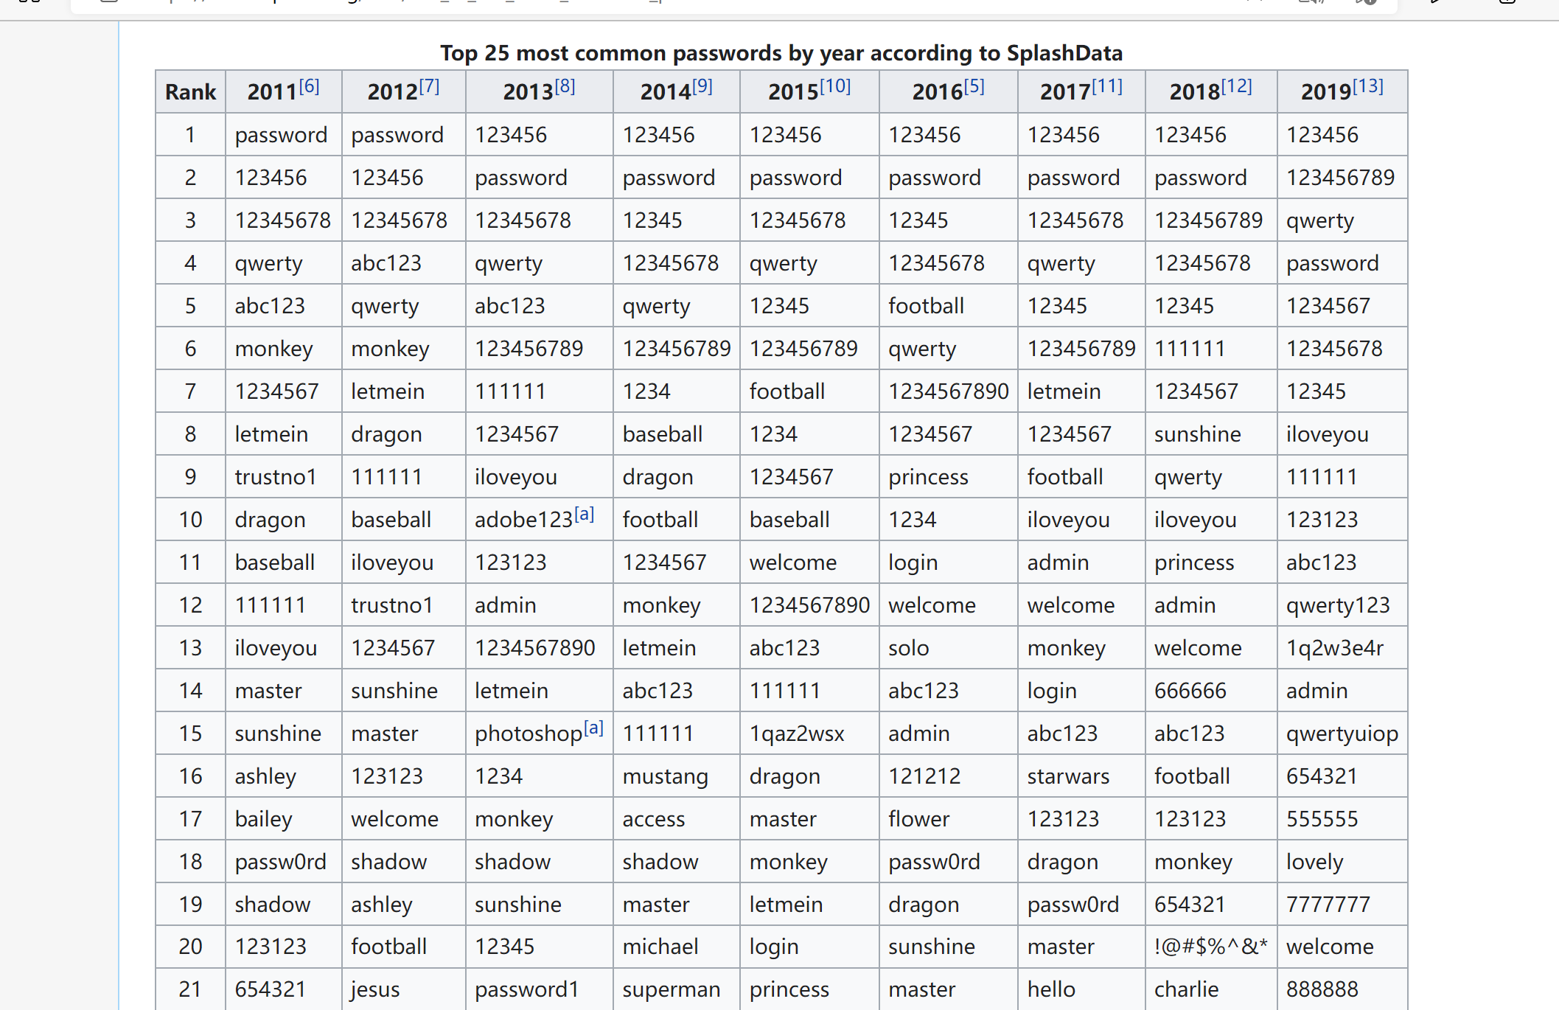
Retrived from: List of the most common passwords - Wikipedia

Slide 7
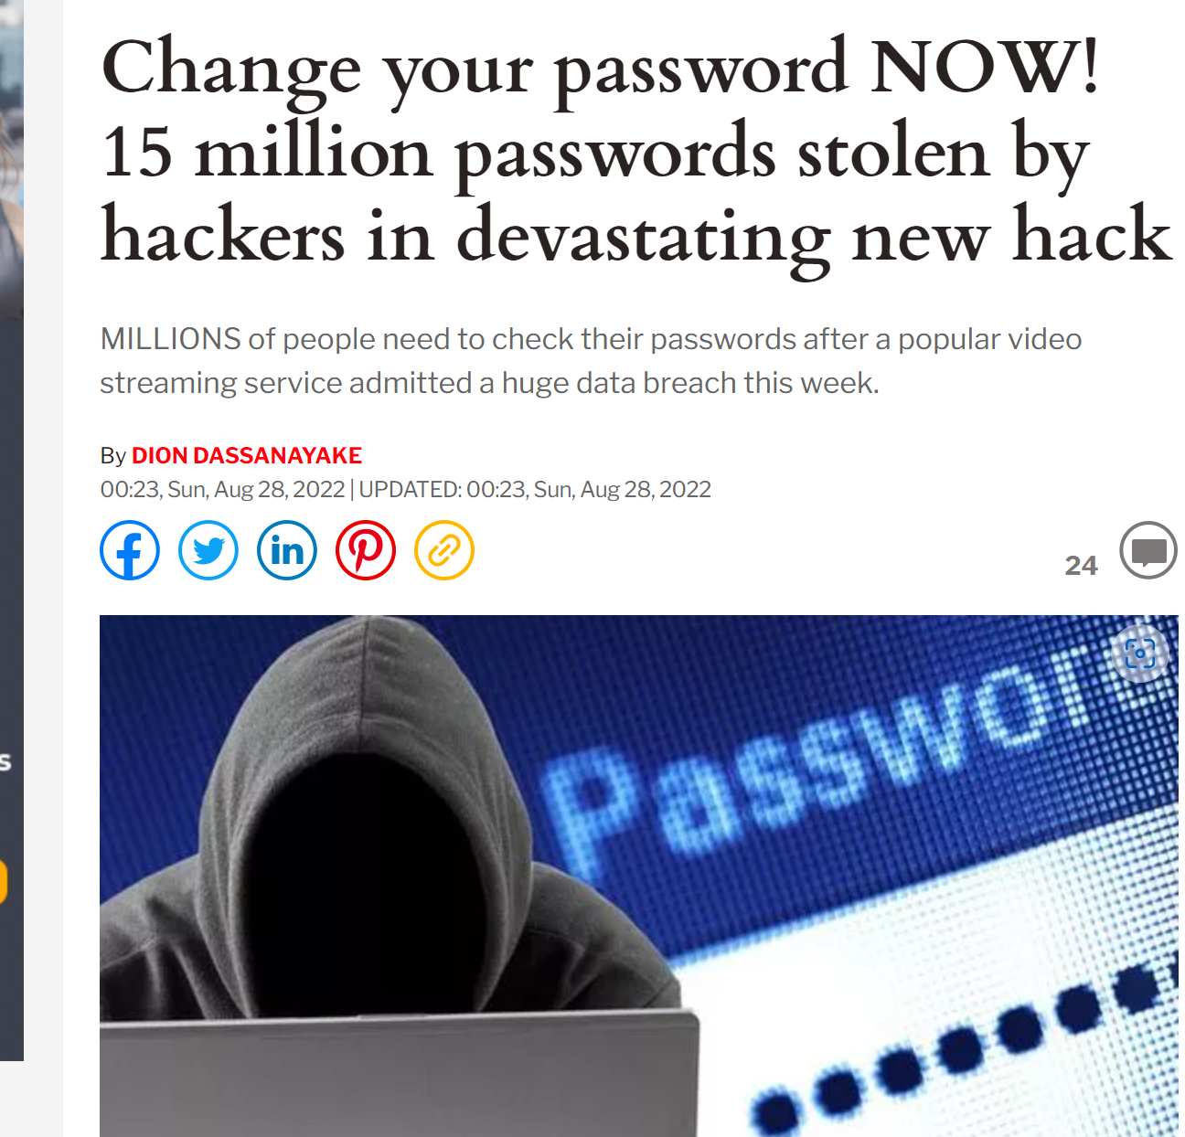
Risks of password leaking
1. Private information exposure
2. Money loss
3. Risks of ID frauds
Retrived from: Change your password NOW! 15 million Plex passwords stolen by hackers | Express.co.uk

Slide 8
Technologies
Web base software
Tools: Apache, Nodejs
Modules: express, ejs, cookie-parser
Languages: Javascript, Javascript( embedded ), Html, css
Request method: POST / GET

Slide 9
methodology
waterfall methodology
The requirements are explicit.
Relative simple system.
Only be used in certain circumstances .
Unlikely to be changed.

Slide 10
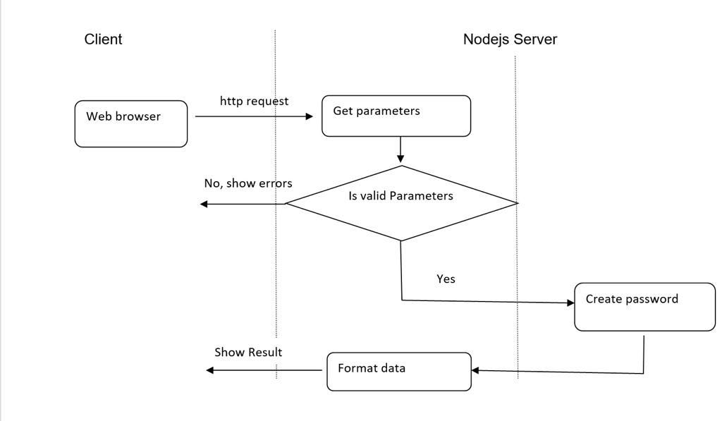
TEAM WORK

Slide 11
TEAM WORK
Client (Richard)
User Interface (Html/ejs, css, embedded javascript)
Server (Steven)
request process (javascript)
. Cookies process (javascript)
Server( Maribeth)
implement of the module - Password Generator (javascript)

Slide 12
Reflections
Maribeth:
Richard:
Steven:

Slide 13
Q&A
Answer Questions

Slide 14
References

